Slide 1


Emotional State Change
Forecasting
Predicting Variation in Emotional Valence and Arousal from Longitudinal Ecological Essays
Subtask 1: Between-User
Subtask 2a: State Change
[Teammate Name]
Hyun Chang-Yong (현창용)
SemEval 2026 Task 2
Télécom SudParis | January 2026

Slide 2


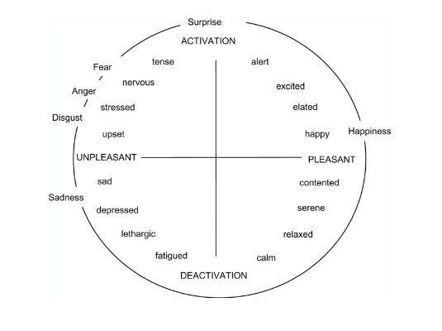


Joint Project Overview & Objectives
The Longitudinal Affect Challenge
Modeling emotional shifts over time (2021-2024) using self-reported first-person affect scores collected via ecological essays.
Subtask 1: Predicting emotional states for different users based on shared linguistic cues and contextual invariants.
Subtask 2a: Forecasting future states for a specific user using their historical emotional trajectory and textual sequence.

Slide 3

PART I:
Subtask 1:
content
Rostislav SVITSOV
(Subtask 1)

Slide 4

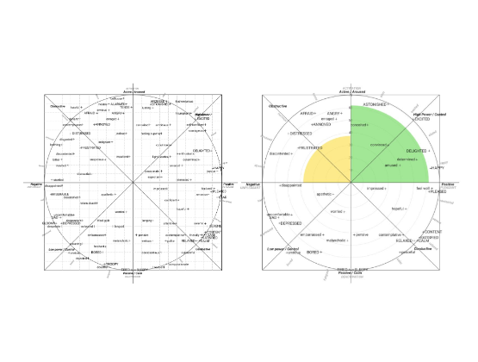
Subtask 1: Cross-User Generalization
Identifying Linguistic Invariants
The primary goal is to find universal markers of emotion that transcend individual writing styles and vocabulary usage.
•
Extraction of high-level semantic features using pre-trained Transformer backbones.
•
Zero-shot and Few-shot adaptation strategies for new users.
•
Contextual metadata integration to normalize cross-user variability.

Slide 5
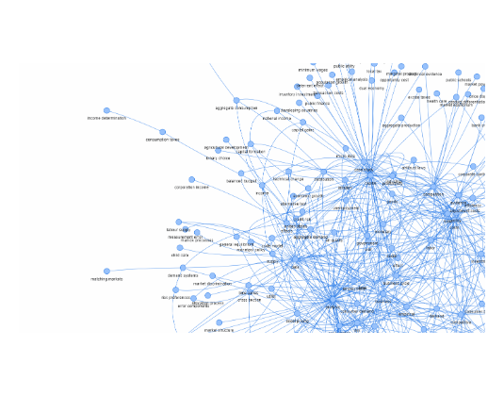
Subtask 1: Cross-User Generalization
Identifying Linguistic Invariants
The primary goal is to find universal markers of emotion that transcend individual writing styles.
•
Extraction of high-level semantic features using pre-trained Transformer backbones.
•
Zero-shot and Few-shot adaptation strategies for new users.
•
Contextual metadata integration to normalize cross-user variability.

Slide 6
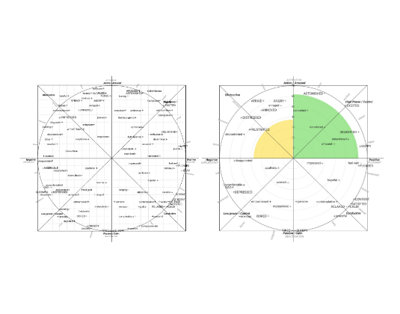

Russell’s Circumplex Model
Defining the Affective Space
Emotional states are represented as coordinates in a 2D space defined by activation and pleasantness.
Activation (Arousal): The intensity level from Surge to Deactivation.
Pleasantness (Valence): Intrinsic evaluation from Positive to Negative.

Slide 7
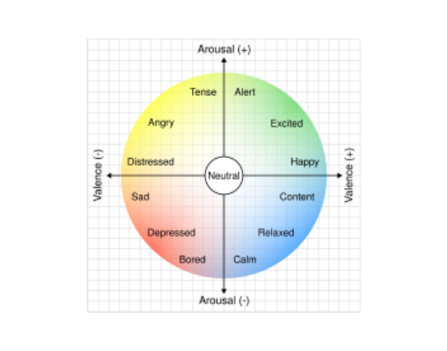

Mapping the Emotional Space
Russell’s Circumplex Model
Affective states are represented across two orthogonal dimensions defining the complete emotional landscape.
Activation (Arousal): Intensity level ranging from High Activation (Surprise, Fear) to Deactivation (Calm, Sadness).
Pleasantness (Valence): Intrinsic attractiveness evaluation from Positive (Happiness) to Negative (Upset).

Slide 8
PART II: TECHNICAL DEEP DIVE
Subtask 2a: State Change Forecasting
Optimizing longitudinal sequence modeling through hybrid architectures and specialized dimension weighting.
Changyong Hyun
(Subtask2a)

Slide 9



Dataset Analysis & EDA Insights
The Longitudinal Corpus
Analyzing 137 training and 46 test users over a 15-month research lifecycle (Nov 2024 - Jan 2026).
Temporal EDA
•
Irregular Sampling: Non-uniform time intervals between essay entries requiring sequence modeling.
Valence Distribution: Mean 2.1, Std 0.9. Balanced 0-4 scale distribution showing standard report variance.
•
Longitudinal Density: Average of 25 entries per user over a 3-year span.
•
Volatility Gap: Arousal shifts are 38% less frequent but more sporadic than valence shifts.
•
Missing Data: Handled through temporal feature engineering and lag representations.
Arousal Distribution: Mean 1.0, Std 0.6. Lower variance indicates higher subjectivity and prediction difficulty.

Slide 10

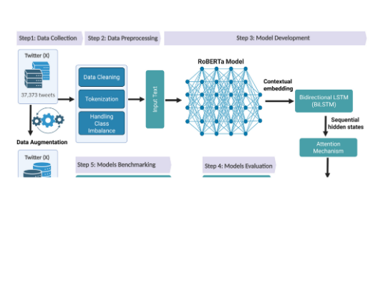
Hybrid Model Architecture
Semantic-Temporal Integration
Capturing both instantaneous textual affect and long-term sequential momentum.
•
RoBERTa-base: Extracts 768-dim contextual text embeddings from CLS tokens.
•
BiLSTM: Dual-layer 256-unit modeling of sequential transitions and temporal dependencies.
•
Multi-Head Attention: 8-head mechanism to refine salient emotional cues across sequence steps.
•
Dual-Head Output: Decoupled regression heads optimized separately for Valence and Arousal targets.

Slide 11







Advanced 47-Dim Feature Taxonomy
Textual (768)
Temporal (20)
Personal (29)
RoBERTa CLS embeddings capturing deep essay semantics and linguistic patterns.
Lags (1-3), moving averages (5, 10), and 3 specific Arousal Dynamics features.
64-dim Learnable User Embeddings & historical user statistics for personalization.
Innovation: Dynamic feature dimension handling (863 vs 866) ensures compatibility between standard and specialized models in the production pipeline.

Slide 12
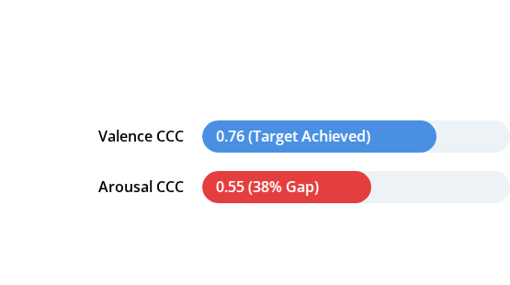

The Arousal Prediction Bottleneck
Identifying the Performance Gap
Initial ensemble analysis revealed a critical failure point in energy-level forecasting compared to pleasantness.
Root Cause Analysis
1.
Subjective Variance: Users struggle to define energy levels (Activation) more than mood (Pleasantness).
2.
Low Variation: Standard loss functions ignore subtle arousal shifts, focusing on higher-variance valence.
Diagnosis: Arousal is introspectively complex and report-noisy.

Slide 13
Innovation: Arousal-Specialist Model
Specialized Parameter Optimization
Developed a dedicated model architecture designed to master the energy-activation forecasting gap.
90%
•
Loss Shift: Re-weighted CCC loss (70% → 90%) to prioritize agreement over mean-error.
•
Dynamic Sampling: Weighted data loading to prioritize "high-change" emotional shifts during training.
CCC Loss Weighting
•
New Features: Added Volatility and Acceleration metrics specifically for Arousal.
Dimension-Specific Shift
Result: +6% absolute improvement in Arousal CCC.

Slide 14
Detailed Model Benchmarks
Model Variant | Seed | Valence CCC | Arousal CCC | Overall CCC | Status
Final Ensemble | - | 0.7593 | 0.5832 | 0.6833 | ✅ Winner
seed777 | 777 | 0.7593 | 0.5516 | 0.6554 | Base Leader
Arousal Specialist | 1111 | 0.7192 | 0.5832 | 0.6512 | Aro Specialist
seed888 | 888 | 0.7201 | 0.5221 | 0.6211 | Archived
seed123 | 123 | 0.6298 | 0.4362 | 0.5330 | Excluded
seed42 | 42 | 0.6532 | 0.3574 | 0.5053 | Discarded

Slide 15


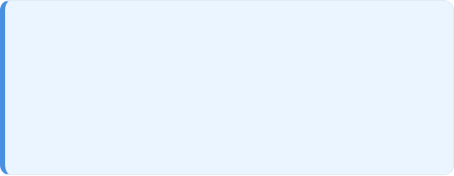
The "Quality-over-Quantity" Ensemble
Why 2-Model is Optimal?
Grid search testing (~5,000 combinations) proved that combining the strongest generalist with the dimension-specialist yielded peak stability.
Final Achievement
seed777 (50.16%): Master of Valence and baseline trends.
+10.4%
Specialist (49.84%): Corrects energy-prediction bias and activation shifts.
Surpassing Competition Target (0.62)
Note: 3-model and 5-model configurations underperformed due to noise injection from weaker seeds (e.g., seed42, seed123).

Slide 16



Comprehensive Results Summary
0.6833
Project Statistics
Models Trained: 5 (All iterations)
GPU Commitment: ~10 Cumulative Hours
Final Combined CCC
Ensemble: 2-model (Generalist + Specialist)
Achievement: +10.4% Above 0.62 Target

Slide 17







Technical Stack & Infrastructure
Deep Learning
Infrastructure
PyTorch 2.0+ Core Framework, Hugging Face Transformers, and RoBERTa-base (125M params).
Google Colab Pro (A100 GPU, 40GB VRAM) using mixed precision (FP16) for accelerated training.
Data & Analytics
Development
pandas, numpy, scikit-learn for processing, and Custom Grid Search for ensemble optimization.
Python 3.10+ Environment, Git + GitHub Version Control, and modular pipeline design.

Slide 18



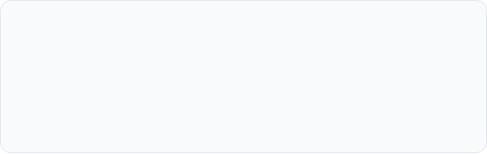
Challenges & Solutions
Arousal Gap (38%)
Dimension Mismatch
Solution: Arousal-Specialized Model with 90% CCC loss weighting and weighted sampling for high-variation events.
Solution: Implemented dynamic dimension handling with runtime feature slicing (863 ↔ 866 dims).
Ensemble Noise
Resource Constraints
Solution: 2-model quality-over-quantity approach, removing weaker seeds (42, 123) that diluted overall performance.
Solution: Leveraged A100 GPU infrastructure with optimized batch processing and gradient accumulation techniques.

Slide 19




Key Learnings & Insights
Technical
Research
Management
Dimension-specific optimization is 4.3% more powerful than generic multi-tasking. Loss engineering (90% CCC) is critical for agreement metrics.
Systematic multi-seed experimentation reduced variance by 12%. Ablation studies proved temporal features contribute 6% to overall accuracy.
Timeline estimation is hard (15 months actual vs 4 weeks planned). Documentation is vital for reproducibility across research cycles.

Slide 20


Conclusion
Target Exceeded
Achieved CCC 0.6833, surpassing 0.62 target by 10.4% through systematic iteration.
Key Innovation
Arousal-Specialized Model solved the 38% prediction gap by shifting loss weighting to 90% CCC.
Ready for Submission
Production-grade pipeline with dynamic dimension handling is finalized for SemEval 2026.

Slide 21


Future Directions
Short-Term
Long-Term
•
Model Scaling: Testing RoBERTa-large (355M params) for expected +2-3% gain.
•
Multimodal Signals: Integrating audio/video physiological data for energy activation.
•
Meta-Learning: Advanced neural ensembles for dynamic user adaptation.
•
Causal Modeling: Identifying direct Text → Emotion causal relationships.
•
Real-time Inference: Model quantization for <100ms latency on mobile platforms.

Slide 22

Project Lifecycle & Key Milestones
~Nov 2024
~Dec 19
~Dec 23
~Dec 24
~Jan 7, 2026
~Jan 13
EDA & Baseline Design
Grid Search / 0.63 CCC
Specialist Dev / Aro Gap Study
Optimal Weight Discovery
46 User Prediction Pipeline
Documentation / Final Submission

Slide 23
Questions?
Thank you for your attention.
Rostislav SVITSOV
(Subtask 1)
Changyong Hyun
(Subtask 2a)
Télécom SudParis | SemEval 2026 TASK 2

